Slide 1
Ultra-High Throughput Low-Power
Packet Classiﬁcation
Author: Alan Kennedy and Xiaojun Wang
Accepted by IEEE Transactions on VLSI

Slide 2
Overview
Decision Tree based Packet Classification
Based on HyperCuts

Slide 3
HyperCuts Review
Dimension to Cut
  The fields with more distinct number of range than mean
Number of Cut
  Max cuts to node i ≤ spfac * sqrt (number of rules at i)
Actually Cutting
  Combination with least maximum number of rule stored in a child
Heuristics
  Node Merging
  Rule Overlap
  Pushing Common Rule Upward
  Region Compaction

Slide 4
Modification
Dimension to Cut
  All fields are considered
Number of Cut
  Larger the number of cut in root-node (seg. Table)
Optimization
  Pushing Common Rule Upward (Too Complicate)
  Modified Region Compaction (Next Page)
  Rule Storage

Slide 5
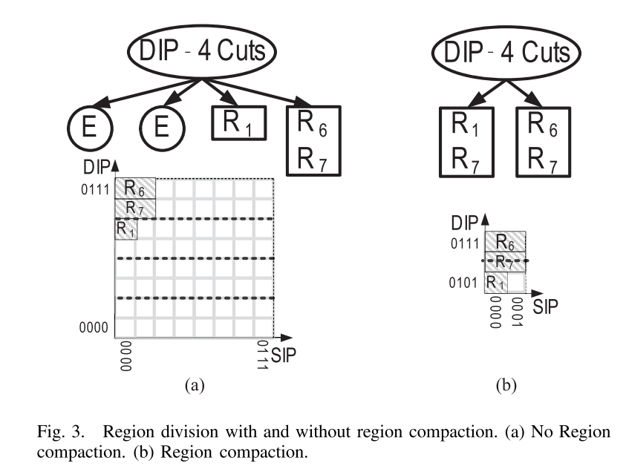
Region Compaction: HyperCuts

Slide 6
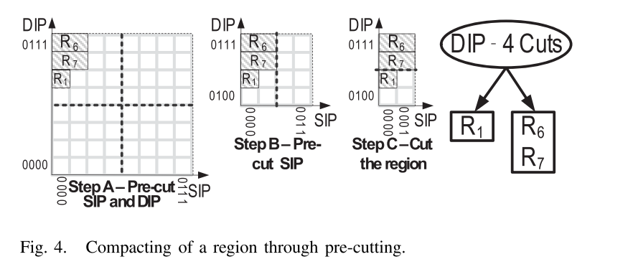
Region Compaction: Modification
Necessary Information:
Number of Cut in each field
Number of Bit in each field

